Slide 1
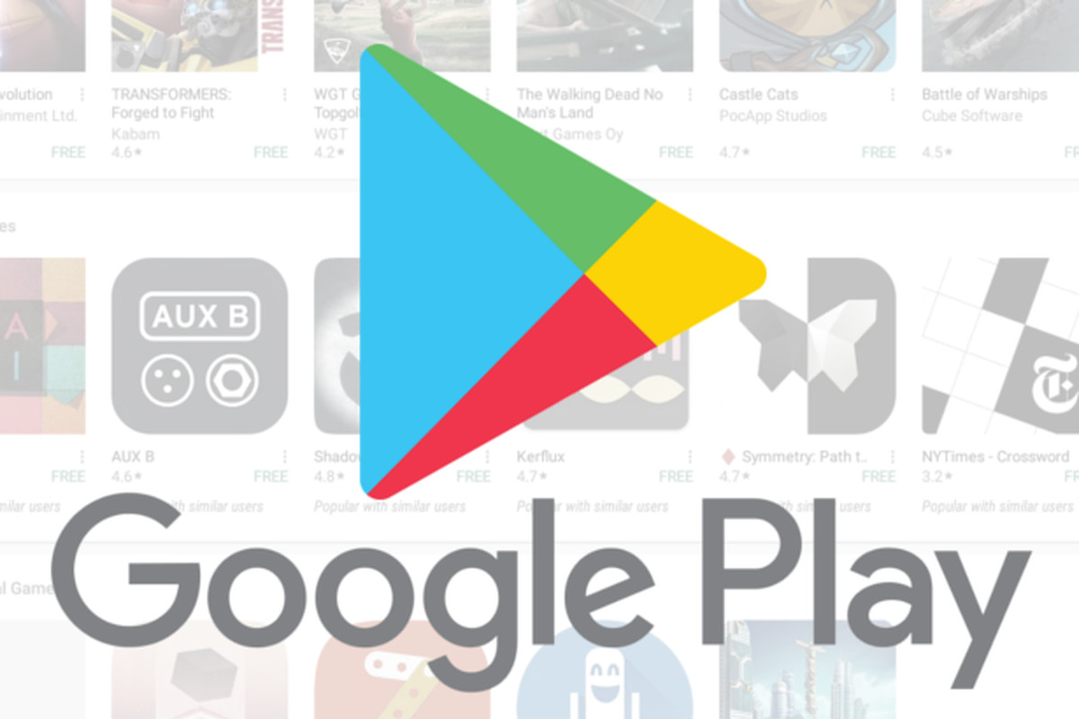
Analysis of Apps in the Google Play Store

Slide 2
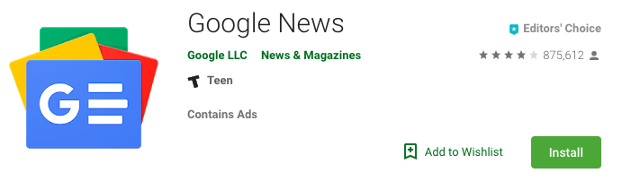
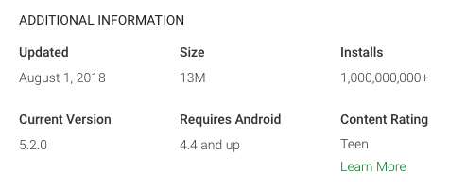
Data Scraping
Collected descriptive information on over 3,100 apps across 11 different categories in the Google Play Store.
Categories included Business, Food & Drink, Books & Reference, Travel & Local, Health & Fitness, News & Magazines, Education, Social, Finance, Medical, and Entertainment.
Scraped app title, category, developer name, whether an app contains ads, rating, number of reviews, app size, number of installs, and price.

Slide 3
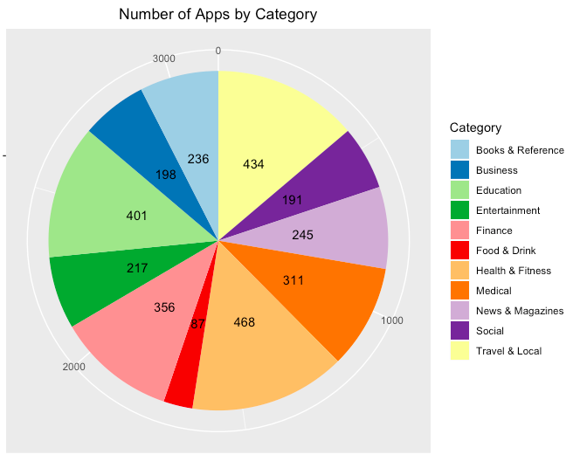
Categories
Health & Fitness, Travel & Local and Education were the most common categories, accounting for about 15%, 14% and 13% of the total number of apps in our dataset, respectively.
Food & Drink was the least prevalent category.

Slide 4
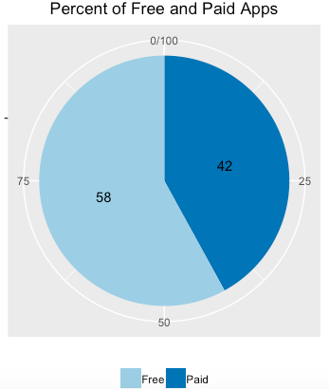
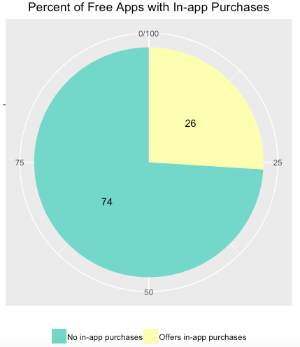
Free vs. Paid Apps
Most of apps were free to install at the time of data collection (58%). However, 26% of free apps had in-app purchases feature, concealing their true cost.

Slide 5
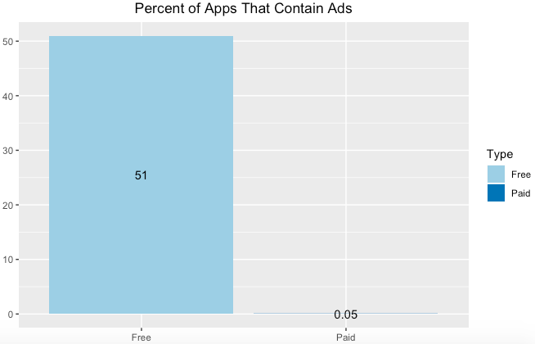
Advertising
51% of free apps were supported by advertising while few paid apps contained ads.

Slide 6
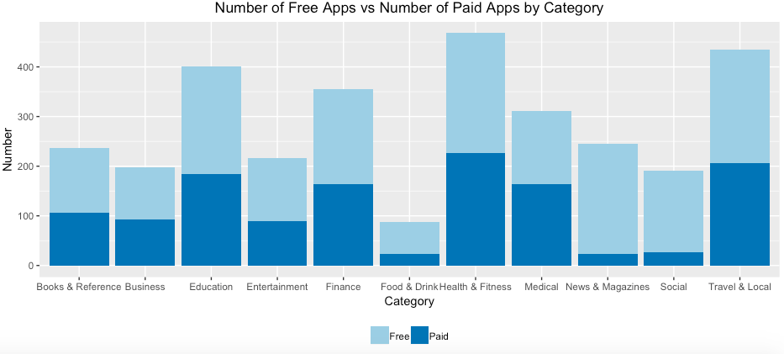
Free and Paid Apps by Category
The majority of apps in Food & Drink, News and Magazines, as well as Social categories were free to install.
Health & Fitness, Travel & Local, Education, and Medical categories had the biggest number of paid apps available for download.

Slide 7
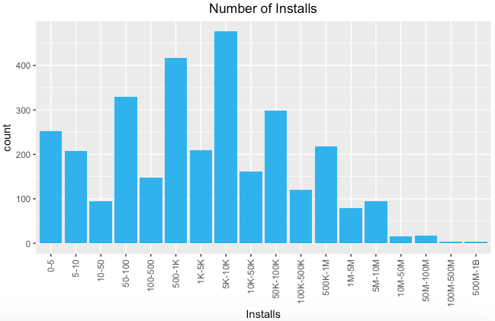
Number of Installs
The Google Play offers a wide range of applications, but most of these apps had been downloaded only by a small number of people. 28% of the apps had been downloaded fewer than 100 times and about 74% of the apps had been downloaded fewer than 50K times.
Among the apps that had been downloaded between 500M to 1B+ times were Instagram, Facebook, Google + and Google News.

Slide 8
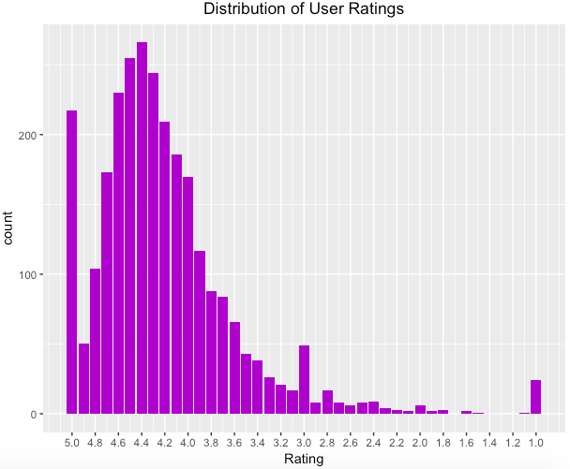
Distribution of User Ratings
266 apps are rated with average rating of 4.4
Most of the apps (74%) are rated within the range of 4.8 to 3.8

Slide 9
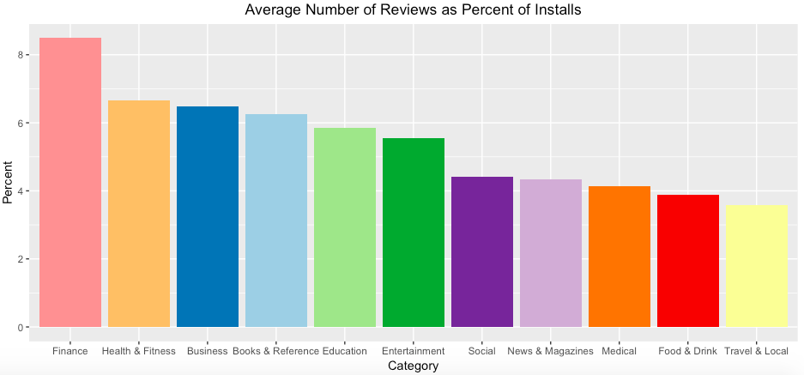
Number of Reviews as Percent of Downloads
On average somewhere between 3% and 8% of users who installed an app write reviews in the Google Play Store. Users tend to leave more reviews for apps in finance, health & fitness, and business categories.

Slide 10
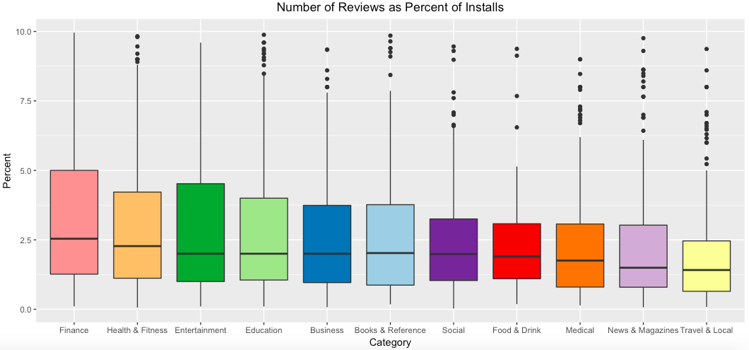
Number of Reviews as Percent of Downloads
The boxplot provides more details on the distribution of user reviews.
Median number of reviews as percent of downloads is about 2.5%, with a range from as little as 0.03% to almost 10%.

Slide 11
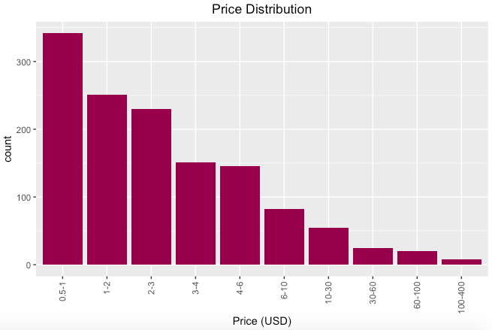
Price Distribution
Most of the apps in the Google Play Store are inexpensive. The majority of apps costs about $1.
The average price of all paid applications is about $6.9.
App prices range from $0.99 to $399.99.

Slide 12
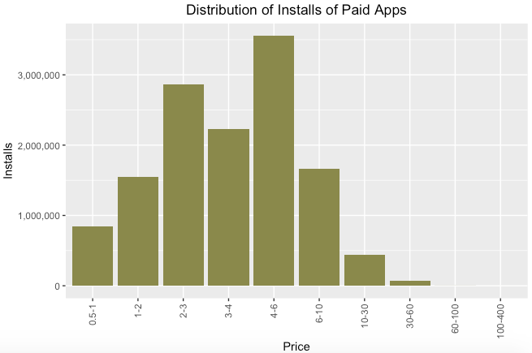
Aggregated Downloads of Paid Apps
Counter intuitively, $2-3 apps and $4-6 apps have more aggregated downloads than cheaper apps which are below $2.
Expensive apps which are above $30 are less popular and there are also fewer of these apps available for download in the Google Play Store.

Slide 13
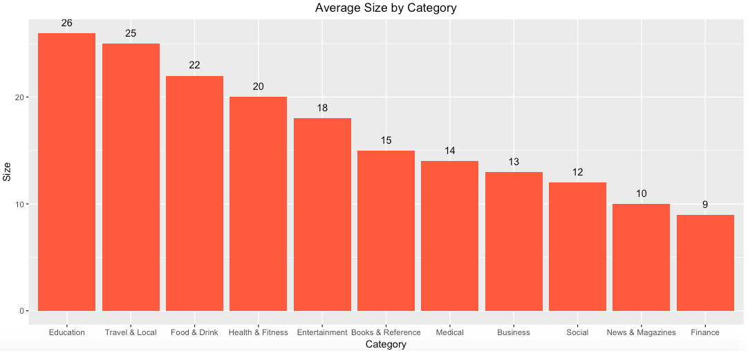
Average Download Size by Category
Average app’s download size in the Google Play Store is 17.3M, with a range between 0.02M and 100M.
Education and Travel & Local categories have the highest average download size while Finance category is the smallest on average.

Slide 14
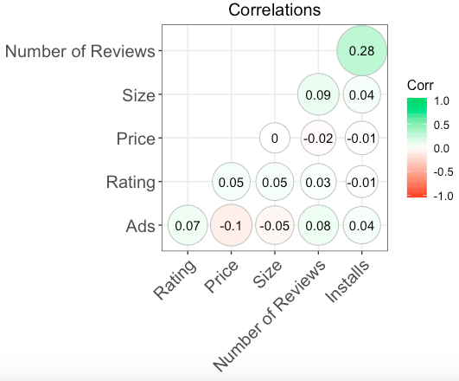
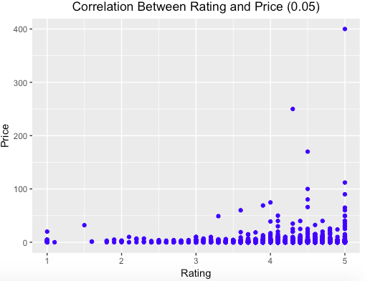
Correlations
We found that there is no correlation between app features such as size, rating, number of installs and price.
Surprisingly, it appears that there is no correlation between price and rating as well as between rating and whether or not an app contains ads.

Slide 15
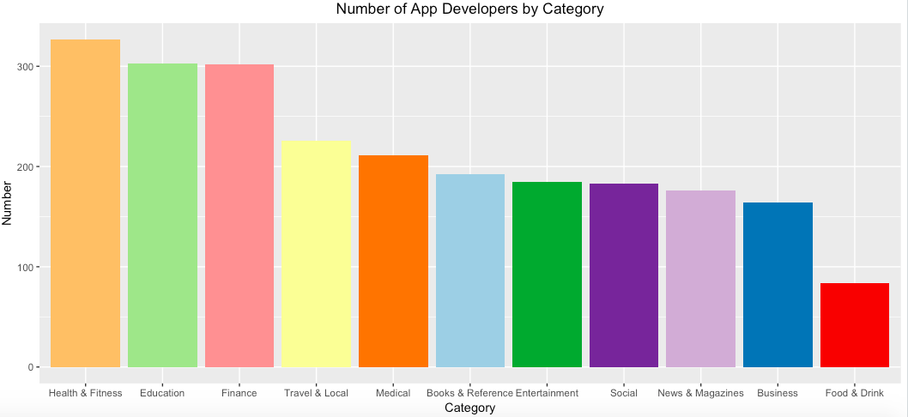
Number of App Developers by Category
The chart below shows the number of unique developers in each category.
Health & Fitness, Education and Finance are the most popular categories among developers.

Slide 16
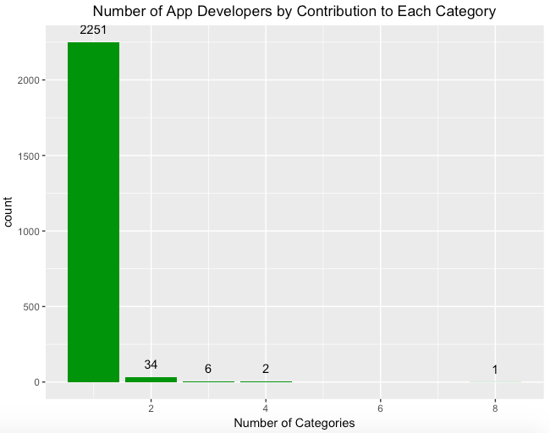
Number of App Developers by Contribution to Each Category
The majority of app developers build apps only for one category (2,251)
Only a small number of developers build apps associated with two or more categories.

